Slide 1
Operations in an Accounting System and Accounting Cycles
MIS 413: SYSTEMS ACCOUNTING

Slide 2
What are Accounting Information Systems?
An information system is a formal process for collecting data, processing the data into information, and distributing that information to users. The purpose of an accounting information system (AIS) is to collect, store, and process financial and accounting data and produce informational reports that managers or other interested parties can use to make business decisions.

Slide 3
MIS = AIS + Other Information Systems (Depending on Organization Type e.g manufacturing, service, or non profit)

Slide 4
Functions of an Accounting Information System
Accounting information systems have three basic functions:
The first function of an AIS is the efficient and effective collection and storage of data concerning an organization’s financial activities, including getting the transaction data from source documents, recording the transactions in journals, and posting data from journals to ledgers.
The second function of an AIS is to supply information useful for making decisions, including producing managerial reports and financial statements.
The third function of an AIS is to make sure controls are in place to accurately record and process data.

Slide 5
Parts of an Accounting Information System
An accounting information system typically has six basic parts:
People who use the system, including accountants, managers, and business analysts
Procedure and instructions are the ways that data are collected, stored, retrieved, and processed
Data including all the information that goes into an AIS
Software consists of computer programs used for processing data
Information technology infrastructure includes all the hardware used to operate the AIS
Internal controls are the security measures used to protect data

Slide 6
Types of Accounting System
Manual ( system contains only human resources)
Computerized or database (system contains only computer resources)
Computer-based accounting system(system contains human, computer and other information technology resources)

Slide 7
Manual System
This is the first type of accounting system. It utilizes paper-based journals and ledgers. Nowadays, Computer-based transaction systems replaced some paper records into computer records. Manual system is labor intensive for this system relies on human processing. Because manual system relies on human processing, they may be prone to error.

Slide 8
Computer – Based Accounting Systems
This encompass the processes and procedures by which an entity’s data and transactions are transformed into accounting information that has value for reporting, planning, controlling and decision making, using computers and applicable information technology techniques in an organized system framework.

Slide 9
Computerized or Database Systems
This system reduces inefficiencies and information redundancies. Relational database systems such as enterprise resource planning (ERP) depart from the accounting equation method of organizing data. This system captures both financial and non-financial data, and then it stores that information in the data warehouse.
The advantages of this system include recognition of business rather than just accounting events; the support in the reduction in operating inefficiencies and; the elimination of data redundancy.

Slide 10
Other Business Systems include the following
Marketing Systems (Customer Relationship, Sales force automation)
Manufacturing Systems ( Manufacturing resource planning, Process control)
Personnel Systems( Personnel forecasting, compensation analysis)
Financial Accounting Systems ( Cash management, Capital budgeting, financial forecasting, investment management)
Accounting systems are designed to support accounting activities. It pictures a model of the organization that stimulates its activities in terms of money. It is mainly concerned with the flow of money. It is a subsystem of the total business system.

Slide 11
Purposes of Accounting systems
Transaction processing.
Formulating business strategy.
Resource allocation decisions.
Budgeting, planning and control.
Performance measurement.
Meeting external regulatory and legal requirements.

Slide 12
The Accounting Process
Figure 1 shows the general flow of the accounting process. The four basic steps involved are:
Analyze transactions,
Record the effects of transaction,
Summarize the effects of transactions and
Prepare records.
This procedure is neutral; this means that the steps involved can be applied both in manual and technology based.

Slide 13
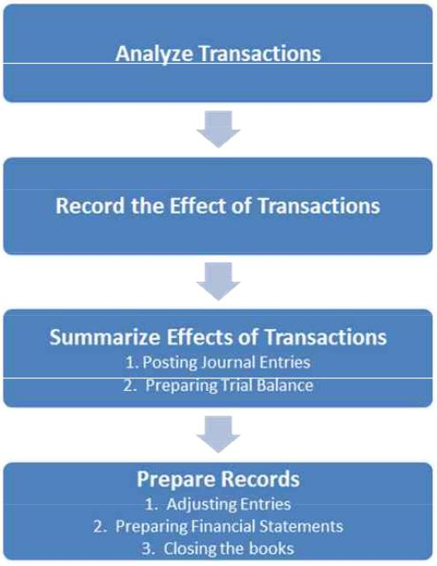
Diagram 1: Accounting Process

Slide 14
Accounting Procoss- Analyzing of Transactions
The first step is the analyzing of transactions, the transaction must be known to be financial in nature, recordable and non-recordable transactions are separated. In this step the transaction is being analyzed on how it affects the accounting equation. Source documents such as invoices, orders, checks are helpful in this stage.

Slide 15
Record the Effect of the Transactions
The second step is to record the effect of the transactions. Transactions are recorded using journal entries. These journal entries are the accountant’s way of recording the effect of both simple and complex business transactions. Journals provide a chronological record of all transactions of a business. They show the dates of the transactions, the amounts involved, and the particular accounts affected by the transactions. Sometimes a detailed description of the transaction is also included. It is also known as the books of original entries.

Slide 16
Summarize the Effects of Transaction
The third step is to summarize the effects of transaction, under this step, the journal entries will be posted to the ledger and a trial balance will then be prepared. Once transactions have been analyzed and recorded in a journal, it is necessary to classify and group all similar items. This is accomplished by the bookkeeping procedure of posting all the journal entries to appropriate accounts. All accounts are maintained in an accounting record called a ledger. A ledger is also referred to as the book of accounts. The next step is to determine the total balance of each account. After the account balances have been determined, a trial balance is usually prepared. A trial balance lists each account with its debit or credit balance.

Slide 17
Preparation of the Reports
The fourth step is the preparation of the reports, this includes adjusting entries, preparation of financial statements and closing of the books. There will be recording and posting of the some adjusting entries that is applicable for the period. Then the trial balance will again be recomputed. From the data in the trial balance, the financial statements are then prepared. This includes the statement of financial position, income statement, cash-flow statement and the notes. The last procedure will be the closing of the books.

Slide 18
Classification
AIS can be classified into financial accounting information system (FAIS) and management accounting information system (MAIS) i.e
AIS = FAIS + MAIS
FAIS is an accounting information system whose objective is to record, process and report past events as financial statements in accordance with established concepts, principles, accounting standards and legal requirements.

Slide 19
Budgeting and other accounting systems intended primarily for the use within the organization constitute MAIS.
MIS = AIS + Other Information Systems (Depending on Organization Type e.g manufacturing, service, or non profit)

Slide 20
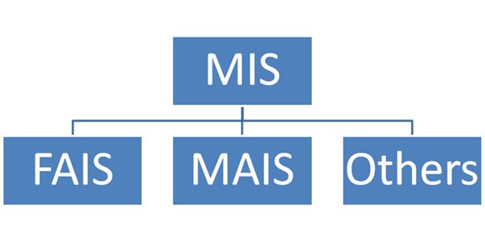
Diagram 2: Components of MIS

Slide 21
Objectives Accounting Information System
For an accounting system to be considered as effective it must meet the basic objectives of information systems.
The first objective is that they must pass the cost benefit principle or cost benefit relationship. Financial information is not free, other companies even spend millions every year just to gather and organize financial information to assemble into their financial statements. Under this principle, the cost of providing financial information in the financial statements must not outweigh the benefit of that information to the users. If the firm is planning to improve their IT system, they must consider the cost-benefit principle.

Slide 22
Objective Cont.
The second objective is to protect the entities assets, to ensure that data are reliable and minimize wastes and the possibility of theft or fraud. This is also known as the control principle.
The third objective is to be in harmony with the entity’s organizational and human factors. This can also be referred to as the compatibility principle.
The last is to be able to accommodate growth in the volume of transactions and for the organizational changes, also called as the flexibility principle.

Slide 23
THANK YOU

